Slide 1
Conversations at the Bedside with Patients and Families: Tools and Tips
Bedside Care Conversations
Dr. Carl J. Logan

Slide 2
What is a Goals of Care Conversation at Bedside?
It is a discussion that happens with a patient who has a serious illness, that patient’s loved ones, and their healthcare team, and whose focus is on the patient’s understanding of their serious illness and their goals for their life, treatment, and spiritual care.
Its intent is to align medical treatments with the patient's personal values, priorities, and quality-of-life preferences, especially in the context of a life-limiting condition or aging.
These conversations are essential for patient-centered care and they ensure that patients receive spiritual care that truly reflect what matters most to them.

Slide 3
General Tips for Bedside Care Conversations
Don’t rush
Listen carefully
Listen for emotional content
Wait for good timing to ask the tough questions, but DO ask them
It’s OK not to know every answer
Don’t assume patients understand
They may misunderstand the disease
Or the situation
Or simply the language (dementia)

Slide 4

Why Bedside Care Conversations Are Important?
The Aim is to have a Goal of Care conversation with the patient and family members
As people age, consideration should be given to their treatment and spiritual care wishes if they lose the ability to manage their care
A large discrepancy exists between the wishes of dying patients and their actual end-of-life care
Most patients look to their clinicians to initiate the discussion
Some clinicians have difficulty having end-of-life conversations with their patients

Slide 5
What constitutes an Effective Bedside Care Conversation with the chaplain?
Understanding that these conversations may be a reoccurring discussion about the patient’s goals, values and treatment preferences instead of seeing it as a one-time activity
1
Including the patient and the surrogate decision maker as often as possible
2
Accommodating diverse belief systems that can shape the treatment decisions
3

Slide 6
Bedside Care: Opportunities for Engagement
Discusses, understands, and plans for future healthcare goals incorporating one’s wishes and values
Leverage these discussions to introduce advance directives
As serious illness progresses focus on care goals, end of life discussions, and role of hospice.

Slide 7
What indicates the need for a Bedside Conversation with the patient and family?
Things seem calm now, but what happens if the waters get rough?
Rapid decline
  Fear
  Grief
  Control
Family (non-patient) emergency
I thought I was on palliative, not hospice
Death in the home
Symptoms
Code status
In/out of hospital

Slide 8

SCREENING TOOLS & RESOURCES For Bedside Coversations
Distress Thermometer: A tool to have caregivers rate their distress from 0 to 10, often accompanied by a checklist of concerns.
Zarit Burden Interview (ZBI-4): A screening tool designed to evaluate the burden of caregiving.
Monitoring Behavioral Changes: Observing for signs of burnout, such as increased outbursts or turning to unhealthy coping mechanisms
When to Intervene
IDG members (nurses, social workers, chaplains) look for signs of "3 Stages of Burnout" (Frustration, Isolation, Despair) to implement interventions like respite care, educational resources, or additional home support
Conversations Needed Frequently:
Continued evaluation about PCG ability to care for the patient as the patient declines
Does the family/caregiver have a good understanding about the progression of the patient’s disease – what to expect?

Slide 9
Tools for Conducting Bedside Discussions
Here are models that are recommended to help anyone conduct an effective Bedside Care conversation
  SPIKES
  ACACT
  Care Conversation Model
Notes:
Bedside

Slide 10


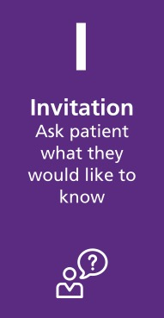
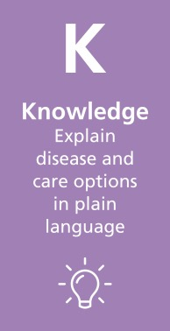
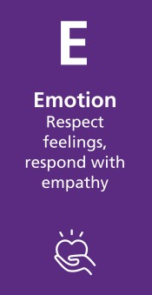

SPIKES

Slide 11
Setting and Listening Skills at Bedside
Encourage patients and families to talk
Acknowledge errors
Be humble
Demonstrate respect
Do not force decisions
Eye contact
Listen carefully before responding

Slide 12
Perception of Patient and Family at Bedside
Patient’s perception of the medical situation
Open-ended questions
What is your understanding of …
Correct misperceptions
Assess acceptance of illness
Denial?
Wishful thinking?
Unrealistic expectations?
Leave out important facts about illness?

Slide 13
Invitation
Inquire how much the patient
wants to know about diagnosis, prognosis, treatment decisions, and recommendations
A substantial minority do not want
to know information
Find out what they do want to know
Changes over the course of an illness
Determine who patient wants to
know what information

Slide 14

Knowledge
Many families do not understand
terms like metastasis or spots
on the liver
Avoid jargon, speak to the level
of patient and family
Avoid excessive bluntness
You are going to die within days”
Avoid phrases like, “There is nothing
more we can do for you

Slide 15
Emotion and Empathy
Emotion and Empathy

Slide 16
Strategy and Summary
Need to ask if they want to discuss care options now or later
A plan helps decrease anxiety and uncertainty
Determine if ready to discuss treatment plan
If not, pick a time to discuss in future

Slide 17
ACACT AT Bedside
Acknowledge- communicates your desire to listen and learn more about the concern
Step 1 Patient and Family: “I am scared.”
Chaplain: “I am impressed by your bravery of letting me know how you feel. It is helpful to know as we explore options together and help you better understand what hospice services entail.”
Step 2 Clarify- ask open-ended questions to uncover and focus on what the specific concern
Chaplain: “I am invested
in helping you. Please share with me what about hospice services scares you.”
Step 3 Answer- Patient and Family: “Hospice is for people who are dying. Are you telling me that I am so sick that I’m dying?”
Step 4 Confirm- Chaplain, “Now that we have had a discussion about why I think hospice would help, do you still have the same feelings we just discussed
Step 5 Transition-Did you earn the right to have a Bedside conversation of what the patient wanted to talk about and theirs concerns? by following steps 1-4?
If you didn’t, and the concern was not completely addressed, or they have additional concerns, do not transition.
Start steps 1-4 again.

