Slide 1



Getting Through The Door
A deeper understanding of the challenges and opportunities surrounding family engagement in visit participation
Dr. Carl J Logan

Slide 2
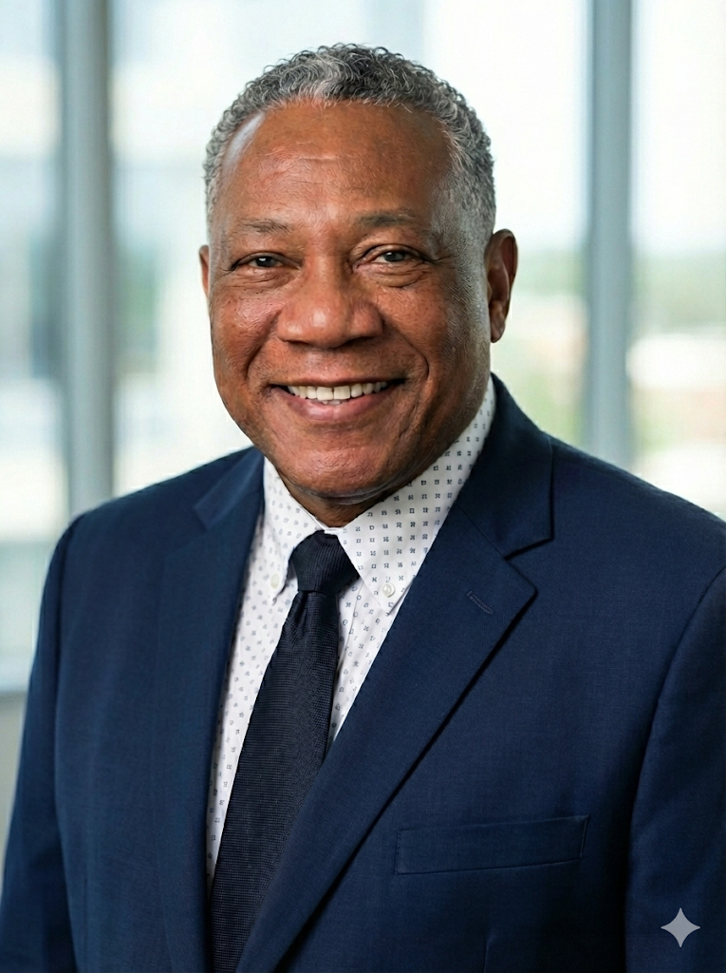
Who is
Carl Logan
800+
patients
I believe in activating dormant potential through deliberate actions such as creating, moving, speaking, and seeing. As a dedicated educator, leader, and minister, I strive to foster cross-cultural, innovative, and successful outcomes through knowledge, caring, and service. I hold a Doctor of Ministry and a Master of Divinity from Golden Gate Baptist Theological Seminary, as well as a Bachelor of Arts in English from Philander Smith College. My professional background is grounded in pastoral care and education.
Since 1996, I have served as the Governing Senior Pastor of Providence Christian Fellowship, where I provide spiritual direction, oversee financial management, and lead evangelism efforts. I have also trained over eighty new pastors to establish their ministries in Jacksonville, Florida, as church planters.
My extensive experience includes my role as a Bereavement Services Manager and Chaplain at Vitas Hospice Home Care (2012–Present), where I coach and train the psychosocial team to ensure proper care and manage spiritual support for a census of 865 active patients. Additionally, I am a Supervisory Education Candidate with Clinical Pastoral Education International, having completed 1600 hours of training by May 2026 over a 12-week period. I have been an ordained pastor since 1996.
In my theory of Pastoral Supervision, I employ a structured process that integrates new interventions for leaders and promotes empathy, assertiveness, and integrity among all participants. Our Lord exemplified compassion during His journey along the dusty roads of Jerusalem, demonstrating deep empathy for those around Him in various situations.
I have also served as a Chaplain at Florida State Prison (2017–2019) and as an English Adjunct Professor at Florida State College at Jacksonville. I am affiliated with the Association of Professional Chaplains and the Jacksonville Baptist Association. I apply my educational background to mentor others and preach the gospel.
80+
pastors

Slide 3
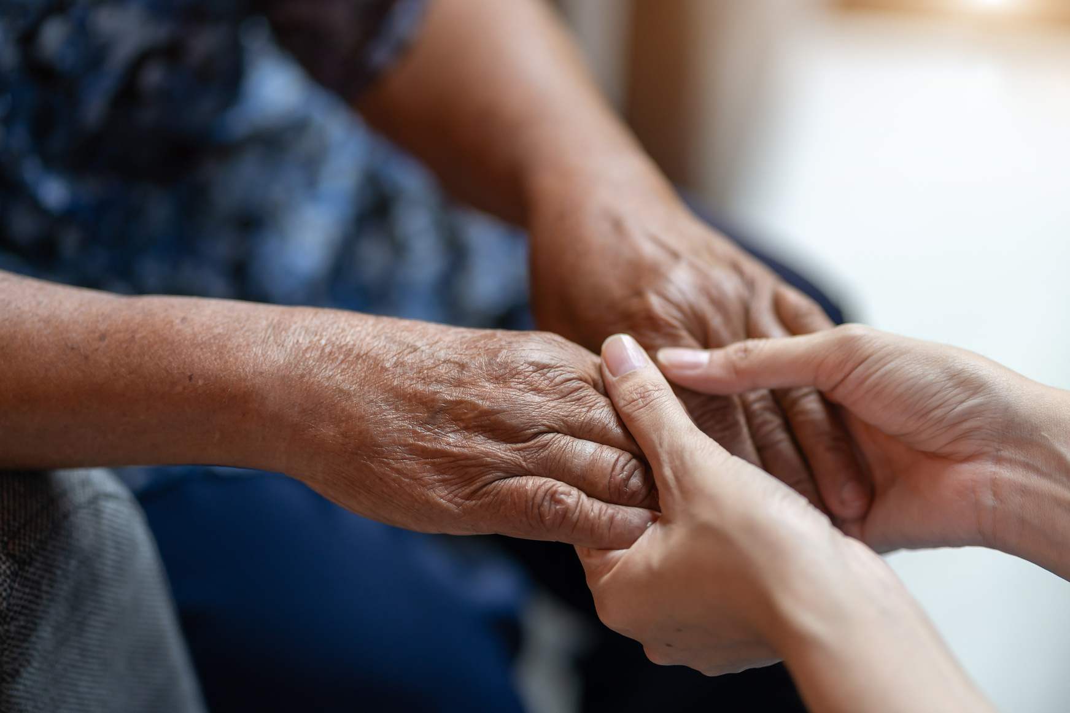

Pastoral supervision and pastoral care have experienced considerable changes over the past decade. Many areas now lack individuals dedicated to advocacy due to a decline in consistent training and a lack of advocates for meaningful conversations with patients. There is insufficient attention to the “Decline in Psychosocial Visits” with chaplains. As other disciplines strive to reach their full potential within their respective fields, the same applies to the psychosocial team.
As part of the Decline Visit Staff Survey, we aimed to gain a deeper understanding of the challenges and opportunities surrounding family engagement in visit participation.
Background
Key Objective
  Gain direct insights from staff on families' decisions and behaviors

Slide 4

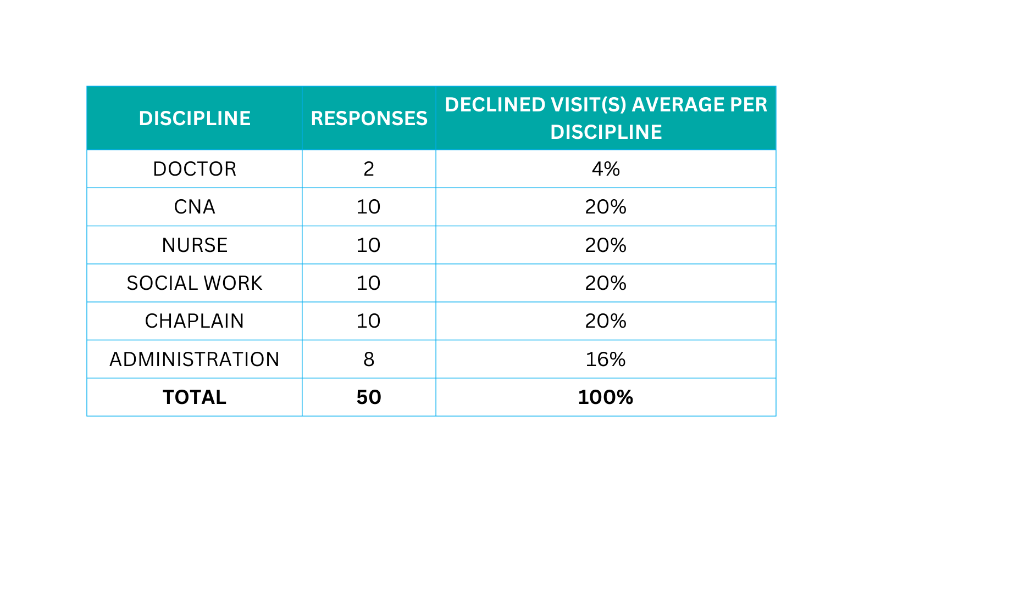

Survey Participants
This study summarizes staff survey responses regarding Psychosocial decline visits. The data reflects input from 50 staff members across multiple disciplines over 90 days. The findings offer insights into declining visit trends and provide staff suggestions for improvement

Slide 5

Critical Survey Questions
Question 1:
Question 2:
What suggestions would you offer to encourage families to accept a visit?
  Capturing staff perspectives on what motivates participation helps inform strategies to strengthen outreach, communication, and overall family engagement.
What are the main reasons families give for their decision to decline a visit?
  Understanding the underlying factors — whether logistical, emotional, or study-related — helps us identify patterns and areas for improvement

Slide 6

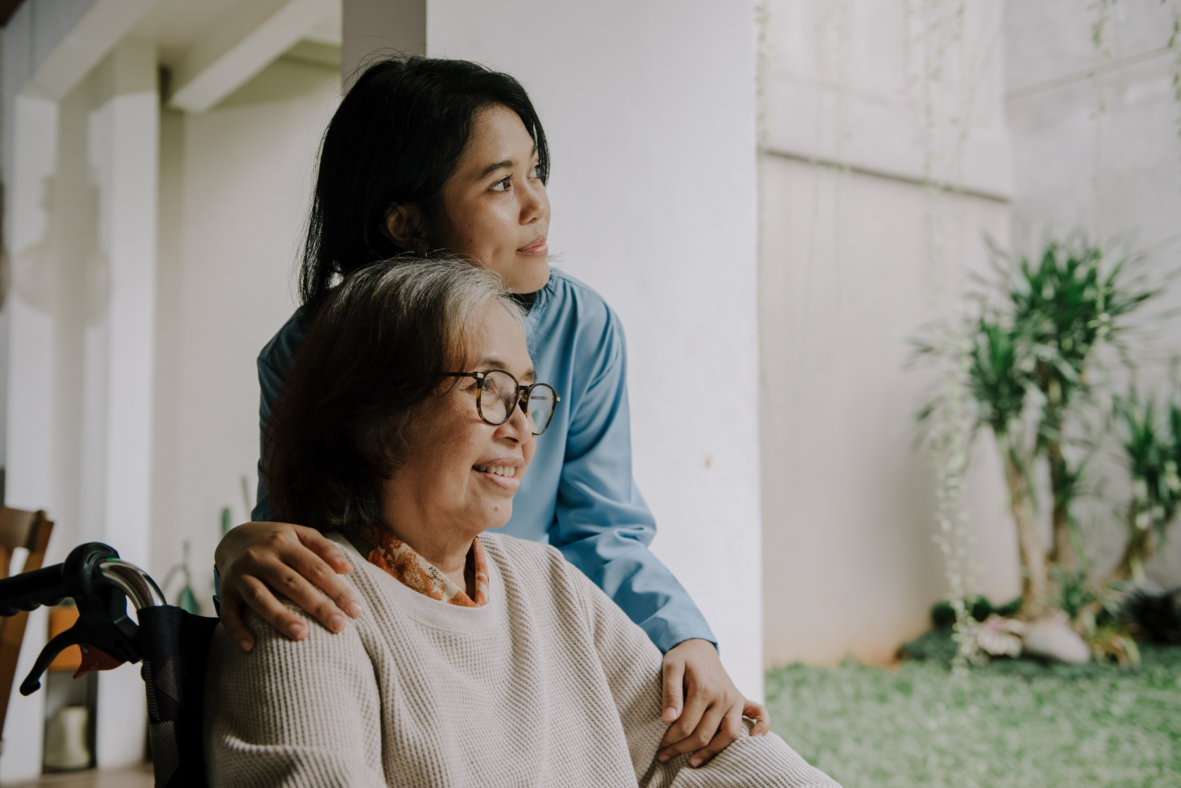



Most Common Responses for Declination Services
  Families felt there were already too many visitors.
  Some families misunderstood the Chaplain’s role as being strictly religious.
  Preference for their own Clergy/Pastors or personal support systems.
  Social Workers work in conjunction with DCF to report abuse and neglect and to have the patient removed from the home.

Slide 7
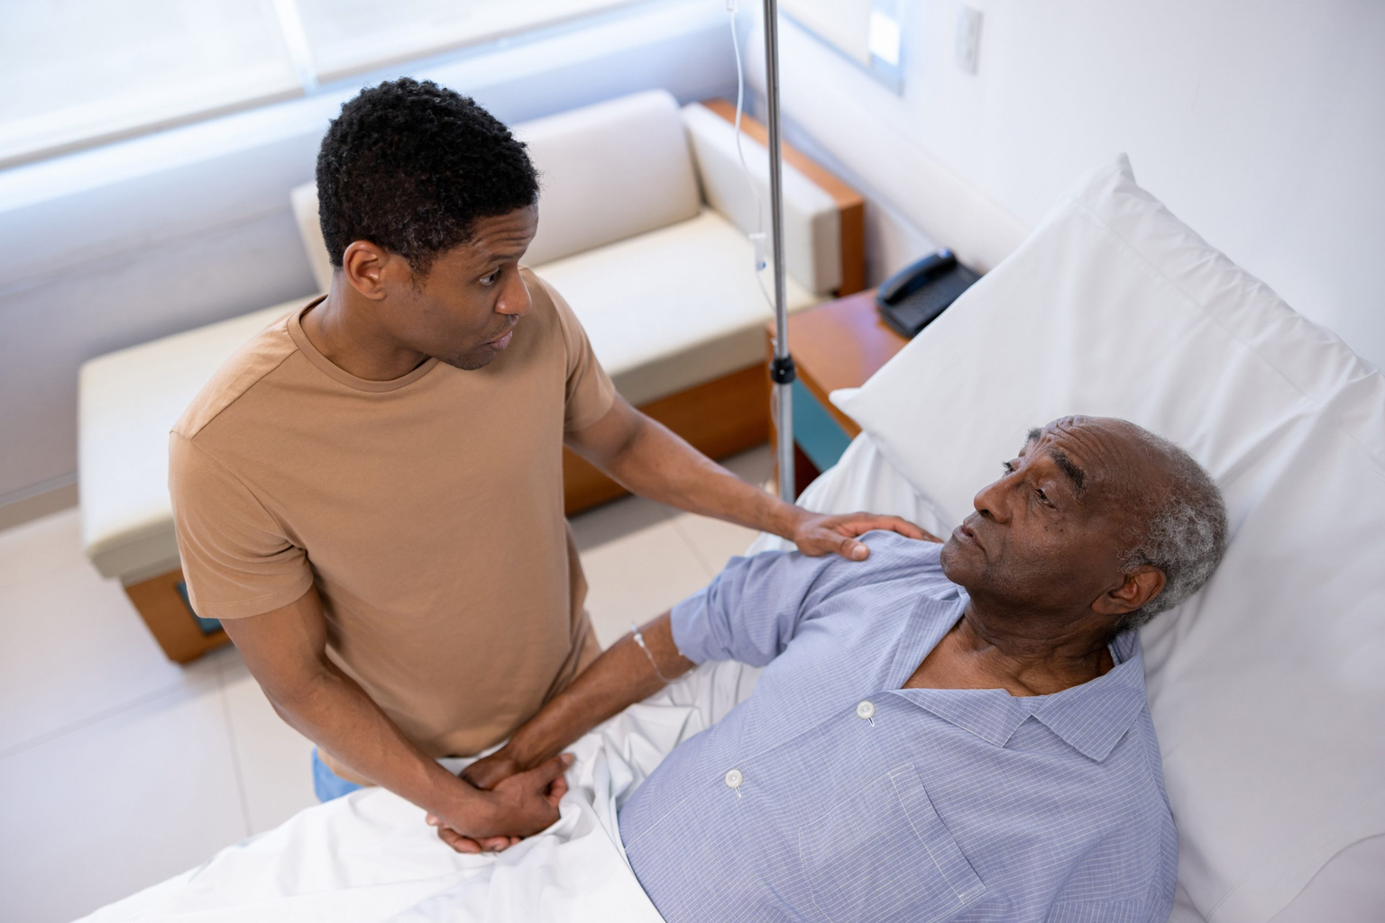

Other Points for Consideration
  Patients and families think the goal is to come in and get them to convert or to do Bible study.
  They are afraid that if the chaplain visits, they are close to death.
  Social workers' visits are typically declined due to fear of being judged for the care they provide.
  Religious leaders are often judgmental toward people who do not share the same deity, faith, or religious tradition.
It is crucial for families to first understand what they may miss out on without the presence of a Chaplain

Slide 8

Participants’ Suggestions to Encourage Visits
  Possible to make the first contact a “Best Practice” with the Chaplain speaking with patients or family and declining a visit.
  Emphasize that Chaplains are supportive, not only religious.
  Ride along with any other discipline to visit (joint visit).
  Call once a month (for check-in) to build a relationship.
  Highlight that Social Workers are not connected to DCF.
  Offer clear communication and reassurance during admission.
  Provide examples of emotional and spiritual support benefits.
  Encourage families to view Chaplains/Social Workers as resources rather than strangers.

Slide 9
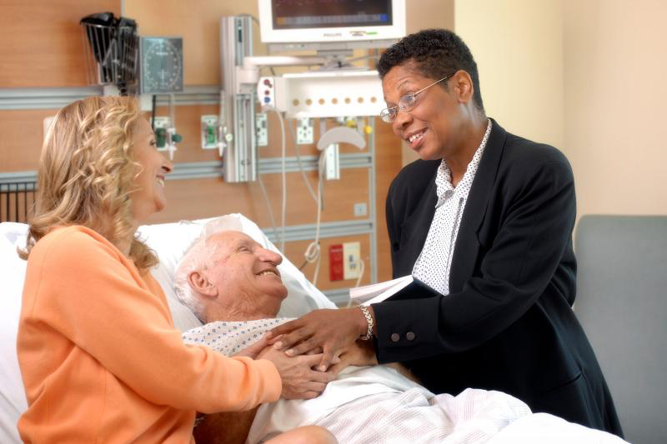
Key Takeaways
Think creatively about ways to engage families
Approach the conversation purposefully when handling a visit declination
Balance between being overly persistent and genuinely caring when expressing a desire to visit a home
Knowing how to engage patients in discussions about their care is becoming increasingly important

Slide 10
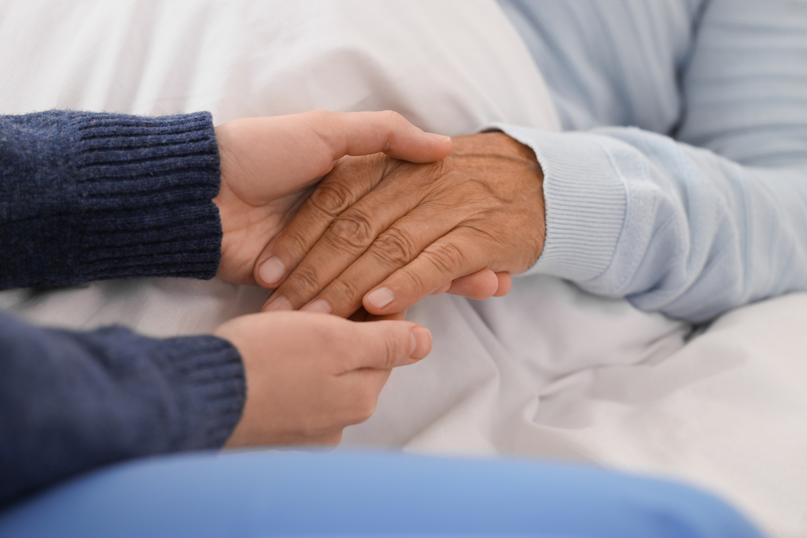

Looking Forward
This study highlights important patterns in decline visits and staff recommendations. Leadership can utilize these insights to
  enhance family education
  mitigate misconceptions, and
  bolster support throughout the admission process
Moving forward, these results can be incorporated into policies, procedures, or best practices within any relevant organization.

Slide 11
The Pinnacle
With years of experience, it is crucial for a chaplain to reach the bedside and engage in conversation with the patient and their family to provide comfort. This is where the chaplain's skills truly shine, providing an additional layer of care. A chaplain should never underestimate the significance of bedside interactions, as they provide encouragement, acceptance, and peace.
I once had a patient in our care who appeared very distraught and was unwilling to engage with any of the other disciplines who came to visit him. One day, making a gentle presence, he welcomed me into his room and offered me a bottle of water. While sitting at his bedside, he expressed a deep yearning to see his children, whom he hadn't seen in seven years due to a bitter divorce. He said to me, "Chaplain, if you can make that happen, I would be grateful to God." He provided me with some old phone numbers to try to contact his children.
I called his ex-wife, and she said she needed to verify that he was in our care. After confirming that information, I mentioned that he would love to see his children, without going into too much detail. That night, he saw all his children. A couple of days later, he passed away. It all began with a simple bottle of water at his bedside.
After nearly 14 years of visiting patients in various settings, I have found that many bedside interactions offer a measure of comfort. While there are occasional instances when this doesn't happen, most bedside conversations provide extraordinary comfort and care to both patients and their families. This ability to connect at the bedside is the ultimate skill set of a chaplain. When a chaplain can get through the door and reach the bedside for conversation, profound care can take place.

Slide 12



Thank You for Your Participation
Dr. Carl J Logan

